Slide 1
The evidence behind a valuation is locked in unstructured documents, spread across systems
01 · What we heard
RAG is the starting point, and ingestion is what makes it work. Valuation belongs in statistical models, not the LLM, with a feedback loop that corrects facts and refreshes the models on a schedule.
Objective
Constraint
Gap in standard RAG
A valuation assistant lending teams can defend
Facts that move value live only in PDFs
Retrieval alone isn't enough
Layout is lost. Tables and page boundaries flatten, so nothing can be cited.
Appraisals, inspections and permits sit in separate systems. For one property:
Answers in seconds, each traceable to its source document and page, and acceptable under appraisal review.
County record | 1,240 sq ft
Inspection, p. 2 | +840 sq ft addition
Nothing is reconciled. Text is never checked against the system of record.
Numbers are ungrounded. The model generates values it can't trace.
Nothing reconciles the two.
Jack Bradham · Practice Customer Engineer, Cloud AI · October 5, 2026
Customer name withheld · synthetic data
Notes:
Open with one line about yourself, then play back what we heard. Better still, ask first: "Where does valuation evidence live today, and what happens when two sources disagree?" Read the slide left to right as a sentence: the objective is a defensible assistant; the constraint is that the facts that move value live only in PDFs across systems; the gap is that retrieval alone can't cite, reconcile or compute. The example is the house in the demo, 14 Larkspur Lane. The county records 1,240 sq ft. Page 2 of a 2025 inspection, in the servicing system, documents a permitted 840 sq ft addition finished in 2024. No system connects the two, so every automated value for this house, and for neighbors that used its sale as a comparable, is wrong. Why an off-the-shelf solution falls short, three reasons: 1. Layout: plain PDF-to-text flattens tables and loses page boundaries, so you can't cite. 2. Reconciliation: the conflict is between a document and a database row; text-only retrieval never compares them. 3. Grounding: in lending, a number the model generated is a liability, not an answer. The subtitle is the thesis of the talk: RAG is the starting point; layout-aware ingestion makes it work; valuation belongs in statistical models (per-neighborhood regressions and a gradient-boosted tree in BigQuery ML), not the LLM; and a feedback loop corrects facts and refreshes the models on a schedule. Transition: "So here's what we built."

Slide 2
A valuation assistant that cites every fact and knows when not to answer
02 · Proposed solution
Ingest
Answer
Guard
Explain
Any PDF becomes typed facts, each tied to its page and quote.
Ask in plain English, follow up, open the cited page.
Conflicting evidence holds the value and routes to a person.
The appraiser's method, step by step, with the real numbers.
5–10 s
~10 s
2
6 steps
per answer, with citations
from comparable sales to checks
new PDF to searchable
approvers per change
Business value
Faster decisions from documents you already hold · fewer values that have to be reworked or repurchased · an audit trail for every number
Measured on the working prototype on Google Cloud
2
Notes:
The pitch in one sentence: a valuation assistant that cites every fact and knows when not to answer. Four things it does, each of which you'll see live: - Ingest: Document AI and Gemini turn a PDF into typed facts with page and quote. A new document is searchable in about 10 seconds. - Answer: plain-English questions and follow-ups, 5 to 10 seconds, every claim linked to its page. - Guard: when a document disagrees with the record, the fact is held, the value is withheld, and a change needs two independent approvers; the loan officer is blocked. - Explain: the appraiser's sales-comparison method, six steps, every adjustment visible. For the VP of Strategy: speed (evidence usable in seconds instead of re-keyed), risk (no value shown on conflicting evidence, audit trail for every number, which cuts rework and repurchase exposure), and leverage (one governed BigQuery store feeds the chatbot, analytics and model training). Don't quote a dollar ROI. Offer to size it in the pilot with their volumes: documents per month, rework rate, cost per appraisal review. Transition: "Here's how it's built, and then I'll show you."

Slide 3
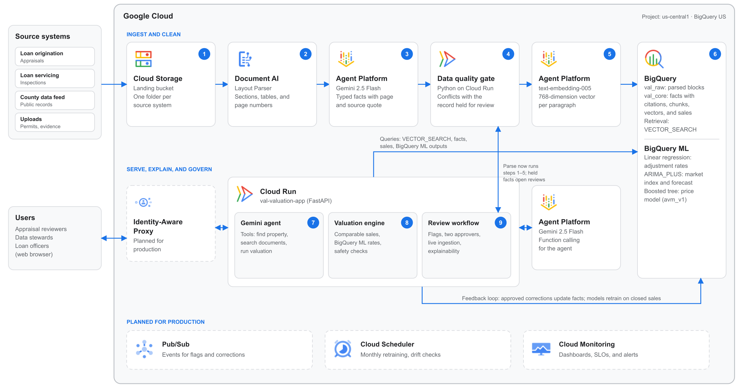
Clean the documents once, then let the agent cite, never compute
03 · Architecture
Live demo
1 · Ask
14 Larkspur Ln: cited answer, value withheld
2 · Govern
Flag, blocked approvers, two approvals, ask again
3 · Ingest
Parse a new inspection live; the data gate holds a conflict
Cloud Storage · Document AI · Gemini Enterprise Agent Platform (Gemini 2.5 Flash, text-embedding-005) · BigQuery · Cloud Run
3
Notes:
Walk the diagram in about a minute. Top row, steps 1 to 6: land in Cloud Storage, parse with Document AI, extract typed facts with Gemini, check them against the record, embed, store in BigQuery. Bottom row, steps 7 to 9: the Gemini agent on Cloud Run, the valuation engine using BigQuery ML rates, and the review workflow; the feedback loop sends approved corrections back to BigQuery. Dashed boxes are production additions. Then switch to the browser. Full script: docs/12-demo-runbook.md. Demo 1, the answer (4 min): "What's 14 Larkspur Ln worth? It's a refi." Show the citation to the inspection page, the issue found by code (not by the model), and "How this value was calculated": step 4 (9 of 12 sales set aside because the living area is wrong) and step 6 (two checks fail, so no number). Follow-up: "What does the permit say?" Point at the Tool calls card: find, search (BigQuery VECTOR_SEARCH), value. Demo 2, guardrails (3 min): Flag the living area. The correct value is blank on purpose: a person declares the truth, with evidence. Review queue: Alex flagged it so can't approve; Jordan, the loan officer, is blocked; Sam and Pat approve. Ask again: $452k to $525k, all checks pass. The model didn't change, the data did. Demo 3, ingestion live (3 min): 18 Larkspur shows a value, but an inspection is on file and not parsed. Press Parse now: Cloud Storage, Document AI, Gemini extracts condition C4, the data check sees the county's C3 and holds it, embeddings, BigQuery, about 10 seconds. Ask again: it now needs an appraiser. If something fails: say so plainly. Each model call has a 20-second limit and falls back to a second region, then the app replays saved answers with a label; don't debug live. If asked about the platform name: Vertex AI is now Gemini Enterprise Agent Platform (renamed at Cloud Next, April 2026); same APIs. If asked why Gemini 2.5 Flash and not 3.8 Flash: I evaluated 3.8 Flash on every demo scenario. Same tool calls and citations; 9 to 19 seconds at a low thinking level, about $0.011 per answer, roughly 3 times 2.5 Flash. It's served only from the global endpoint for this project, and this afternoon 6 of 6 calls timed out. So the demo pins 2.5 Flash in us-central1, and 3.8 is a one-line configuration switch. Pin, evaluate each release, then switch.

Slide 4
Under a dollar to read a loan file once; about half a cent per valuation after that
04 · Cost to run
Unit economics, at list price
Illustrative pilot
Per page ingested | Rate | Cost
Document AI Layout Parser | $10 per 1,000 pages | $0.0100
Gemini 2.5 Flash extraction | ~1k in, ~1.25k out tokens | $0.0034
text-embedding-005 | $0.000025 per 1k chars | $0.0001
Total per page |  | ≈ $0.014
Per answer
Gemini 2.5 Flash, 4 calls | 5.9k in, 0.6k out tokens | $0.0033
BigQuery vector search | within 1 TiB free tier | $0
Per valuation
First, ~60-page loan file | 60 pages parsed + 1 answer | ≈ $0.85
Re-valuation | 1 answer + Cloud Run share | ≈ $0.005
One county: 100,000 pages of backlog, 20,000 questions a month
~$1,350
one time, to parse the backlog
~$110
a month: answers $66 · Cloud Run $44 · BigQuery $0
Levers: Document AI savings plan ($8 per 1,000 pages), a capped Gemini thinking budget for extraction, parse only new documents.
Google Cloud list prices, us-central1, October 2026 · token counts measured on the prototype · excludes people and support
4
Notes:
The message for the VP, in one line: "Under a dollar to read a full loan file once, then about half a cent per valuation after that. Cost scales with documents, not questions." Per valuation: a typical loan file is assumed to be about 60 pages (appraisal about 30, inspection about 25, permits about 5; our demo PDFs are 1 to 2 pages, so say it is an assumption). 60 pages at about $0.014 = about $0.84, plus one answer at $0.0033, so about $0.85; parsing is about 98% of it. A re-valuation reuses the parsed pages: one answer ($0.0033) plus a share of the always-on Cloud Run instance (about $44 a month over 20,000 answers, about $0.002), so about $0.005. On Gemini 3.8 Flash a re-valuation would be about $0.013. Answering is nearly free, about a third of a cent; the cost is reading each page once, about 1.4 cents, three quarters of it Document AI. Where the numbers come from: - Rates are Google Cloud list prices, us-central1, checked October 4, 2026: Document AI Layout Parser $10 per 1,000 pages ($9 or $8 on savings plans); Gemini 2.5 Flash $0.30 per million input tokens and $2.50 per million output tokens (thinking tokens bill as output); text embeddings $0.000025 per 1,000 characters; BigQuery on-demand $6.25 per TiB with the first TiB free each month and the first 10 GiB of storage free; Cloud Run $0.000018 per vCPU-second and $0.000002 per GiB-second. - Token counts were measured on the prototype: one answer took 4 Gemini calls, 5,862 input and 607 output tokens. Extraction of a 2-page inspection took 481 input and 2,509 output tokens, mostly thinking; per page I assume about 1,000 input tokens (a fuller real page) and 1,250 output. - Pilot assumptions are illustrative, not the customer's numbers: 100,000 pages, 20,000 questions a month, one always-on Cloud Run instance (1 vCPU, 512 MiB) after the free tier. If asked about ROI: compare cost per answer and per page with what an analyst-hour or a reworked valuation costs them; offer to size it with their volumes in the pilot. Don't quote their numbers for them. If asked about Gemini 3.8 Flash: evaluated on October 5. About $0.011 per answer (6,065 input and about 275 output tokens at $1.50 and $7.50 per million), so answers would be about $225 a month in the pilot instead of $66. Same answer quality; it timed out on its only endpoint that afternoon, so the demo pins 2.5 Flash. If asked how to cut cost: Document AI savings plan, cap the thinking budget on extraction (most extraction output is thinking), only parse new or changed documents (content-hash cache), batch the backlog.

Slide 5

What we decided, what we traded, and what production needs
05 · Considerations
Decisions and trade-offs
Prototype to production
We chose | Because | We accept
BigQuery vectors, not a separate vector DB | Vectors, facts and records in one governed store | Agent Platform Vector Search at high query volume
Layout Parser + Gemini, not plain OCR | Keeps tables, sections and the page | A per-page parsing cost, cached by hash
Model explains, engine computes | Every number traces to a tool output | More build than prompt-only RAG
Hold conflicts, two approvers | One bad fact can't poison many values | Some answers wait for a person
0–30 days · Pilot
One county, real documents, accuracy vs. appraiser review
30–90 days · Harden
IAP, least-privilege IAM, review state in BigQuery, BigQuery ML price model
90+ days · Scale
Document AI batch, more counties, drift monitoring per neighborhood
Full design notes and FAQ · "Valuation assistant prototype: scope, design decisions, and path to production" (Google Doc): what we built, what's out of scope, and what production needs
Next step: which county and which document types should the pilot start with?
5
Notes:
Use this slide to open the discussion, not to read it. Pick the row the technical stakeholder reacts to. Decisions: - BigQuery vector search vs. a dedicated vector DB: at this scale, vectors next to the facts and property records means retrieval and the contradiction check are joins in one governed store. At high QPS, swap the retrieval function (agent/retrieval.py, about 30 lines) to Vector Search in Gemini Enterprise Agent Platform (formerly Vertex AI). - Layout Parser plus Gemini vs. plain OCR: the key fact sits beside a table on page 2; keeping layout and page is what makes citation possible. Parsing calls are cached by content hash. - Model explains, engine computes: the prompt forbids numbers, and when the engine withholds a value the tool doesn't even return the range; there's a test for that. - Holds and two approvers: the manipulation control regulators ask for. Cost: some answers wait for a person. Prototype shortcuts, owned plainly: the service account is over-privileged (production: BigQuery Data Editor and Job User, Document AI API User, Agent Platform user (roles/aiplatform.user), Storage Object Viewer); demo users are a dropdown (production: IAP and Google identity); review state is in memory on one instance (production: BigQuery); the price model is a formula (production: the BigQuery ML model already trained); Riverside's market drift is seeded. Point to the Google Doc for everything the slides leave out: build history, design decisions, lessons from testing, measured results, the cost model, and an FAQ that answers each gap with "In the prototype" and "In production". Offer to share it after the session. Close with the question on the slide, then Q&A.

